Slide 1
CS202
COMPUTER ORGANISATION & ARCHITECTURE

Slide 2
MODULE I
Basic functional units & operational concepts
Memory Organisation & Operations
Instruction sequencing
Addressing modes with ARM example
Stacks & subroutines

Slide 3
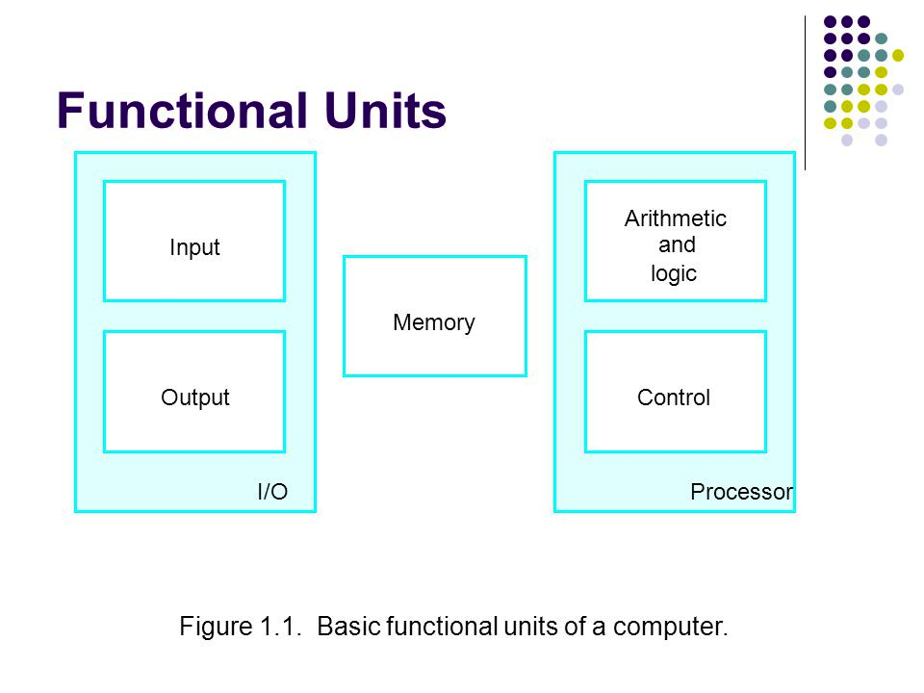
Basic Functional Units

Slide 4
BASIC OPERATIONAL CONCEPTS
Any activity in a computer is governed by instructions.
To perform a task, an appropriate program consisting of a list of instructions is stored in memory.
Individual instructions are brought to processor,which executes the specific operations.

Slide 5
The processor contains registers used for different purposes.
There are n general purpose registers R0 toRn-1.
The instruction register (IR) holds the instruction that is currently being executed.
The Program Counter (PC) contains the memory address of the next instruction to be fetched and executed.

Slide 6
While the current instruction is being executed, the contents of PC will be updated to point to the next instruction to be fetched and executed.
The memory address register (MAR) holds the address of location to be accessed in memory.
The Memory Data Register (MDR) temporarily holds the data to be written into or read out of the addressed location.

Slide 7
Programs are fed into memory through the input unit.
Execution of program starts when PC points to the first instruction of program.
The contents of PC are transferred to MAR and a read control signal is send to memory.
The addressed instruction is read out of memory and loaded into MDR.
Next the contents of MDR are transferred to IR. Now , the instruction is decoded and executed.

Slide 8
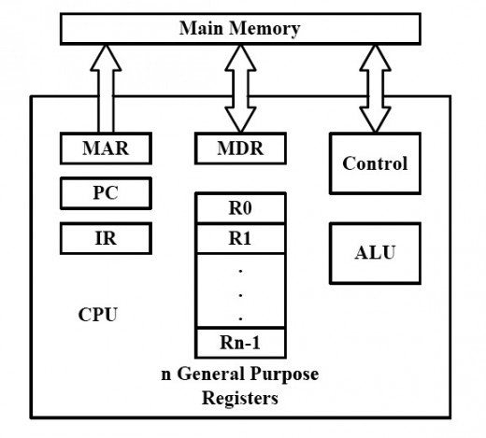

Slide 9
The form an operational system, the parts of the computer must be connected together in some way.
When a word of data is transferred between units, the bits are transferred simultaneously over many wires or lines, one bit per line.
A group of wires which act as a connecting path between several devices is called a bus.
The bus has separate lines for carrying data, address and control information.

Slide 10
PROCESSOR CLOCK
Processor circuits are controlled by a timing signal called a clock.
The clock defines regular time intervals, called clock cycles.
To execute an instruction, the processor divides the action to be performed into a sequence of basic steps, each to be completed in one clock cycle.

Slide 11
Let P be the length of a clock cycle.
Its inverse, R=1/P, is called the clock rate, which is measured in cycles per second or hertz(Hz).

Slide 12
Let T be the processor time required to execute a program that contains N machine language instructions.
Let S be the average number of basic steps required to execute on instruction, where each step is completed in one clock cycle.
If the clock rate is R cycles per second, the program execution time is given by, T = (N x S) / R

Slide 13
MEMORY ORGANISATION
The data and instructions are stored in the memory of a computer.
Memory consists of many million storage cells, each of which can store a single bit.

Slide 14
Usually the cells are handled in groups of n bits, such that a group of bits can be stored or retrieved in a single basic operation.
Each group of n bits is called a word and n is referred to as word length.
A unit of 8 bits is called a byte.

Slide 15
Modern computers have word lengths ranging from 16 to 64 bits.
If the word length of a computer is 32bits, a single word can store 4 bytes of data.
Within the memory, each location has a distinct address, so that its contents can be accessed without ambiguity.

Slide 16
Usually the numbers 0 to 2^{k}-1, for some suitable value of k is used as addresses of successive locations in memory.
The 2^{k} addresses constitute the address space of the computer and the memory can have up to 2^{k} addressable locations.
For example, if k=24, we have a 24 bit address and an address space of 2²⁴ locations.

Slide 17
In memory, successive addresses refer to successive byte locations.
Such a memory is called a byte addressable memory.
If the machine has a word length of 32bits, successive words are located at addresses 0,4,8,... with each word containing 4bytes.

Slide 18
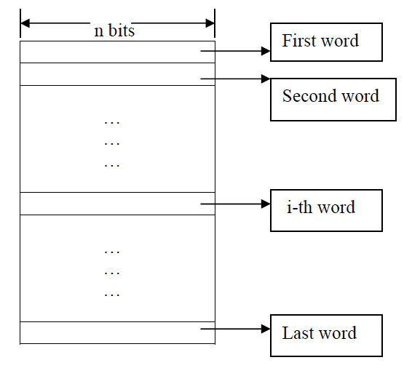

Slide 19
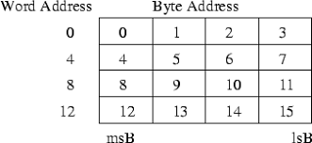

Slide 20
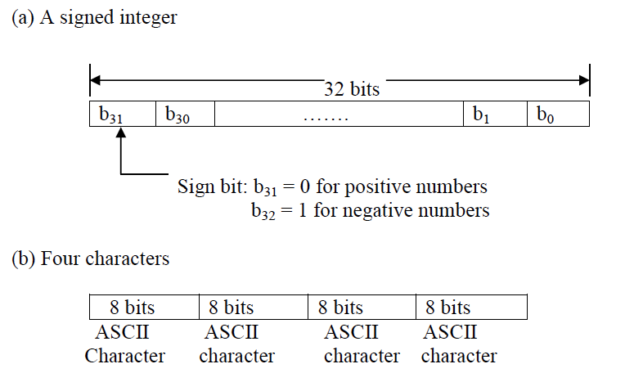

Slide 21
There are two ways in which byte addresses can be assigned across words – big endian and little endian assignments.
In big endian assignment, the lower addresses are used for more significant byte (leftmost bytes) of the word.
In little endian assignment, lower addresses are used for less significant (rightmost ) bytes of the word.

Slide 22
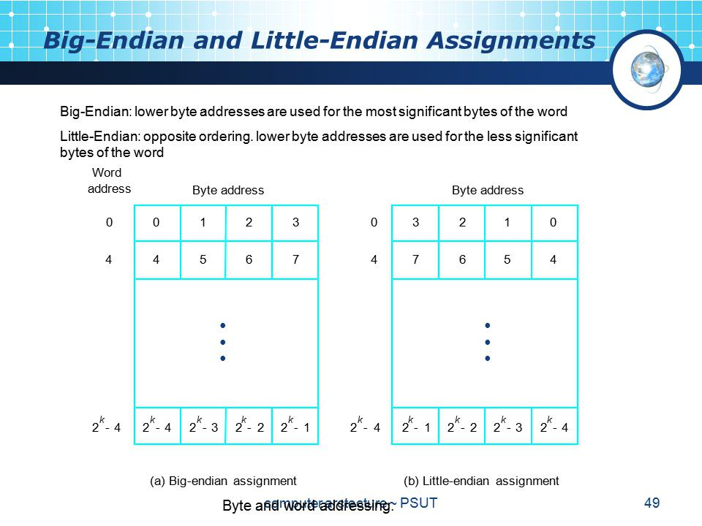

Slide 23
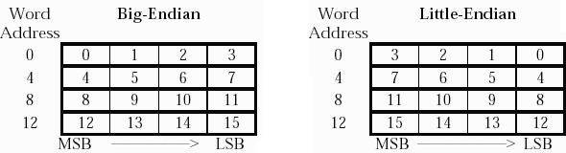

Slide 24
The two basic operations involving memory are the Read (Load or Fetch) and Store (Write).
During Load operation, a copy of the contents of the memory location is transferred to processor.
Memory contents remains unchanged.

Slide 25
Store operation transfers information from processor to a specific memory location.
This destroys the former contents of that location.
A data item of size 1 byte or 1 word can be transferred between processor and memory in a single operation.

Slide 26
Instructions
A computer must have instructions capable of performing four types of operations:
Data transfer
Arithmetic & logic Operations
Program sequencing and control
I/O transfers

Slide 27
Instructions can be represented using either:
  Register Transfer Notation
  eg: R1<-- [LOC]
  R3<-- [R1]+[R2]
  Assembly Language Notation
  eg: Move LOC,R1
  Add R1,R2,R3

Slide 28
Basic instruction types are:
Three Address Instruction
General format is: Operation Source1, Source2, Destination
eg: Add A,B,C
A and B are the source operands and C is the destination operand.
Instruction size is too large to fit in to an average word size

Slide 29
Two Address Instruction
General format is:
Operation Source, Destination
Eg: Add A, B, which performs [B]<--[A]+[B]
If we don't want to destroy the contents of B,one more instruction should be used.
Move B,C // [C] <-- [B]
Add A,C // [C] <--[A]+[C]

Slide 30
One Address Instruction
The machine instructions specify only one memory operand.
When a second operand is needed, it is understood to be implicitly present in an unique location.
A processor register, called Accumulator is used as this unique location.

Slide 31
For example, Add L1 means to add the contents of memory location L1 to content of accumulator register.
C<--[A]+[B] can be performed by the following one address instructions:
Load A // Copy contents of location A to Acc
Add B // Add contents of B to Acc
Store C // Write contents of Acc to location C

Slide 32
Instruction Sequencing
Executing a given instruction is a two phase procedure.
First phase is called instruction fetch, and here the instruction to be executed is fetched from memory
The second phase is instruction execute, where the required operations are done by the processor.

Slide 33
STRAIGHT LINE SEQUENCING
At some point during these two phases, the content of PC is updated to point to the next instruction.
If the content of PC is updated in order of increasing address, it is called straight line sequencing.
Here the instructions are executed in the same order as they appear in the program.

Slide 34
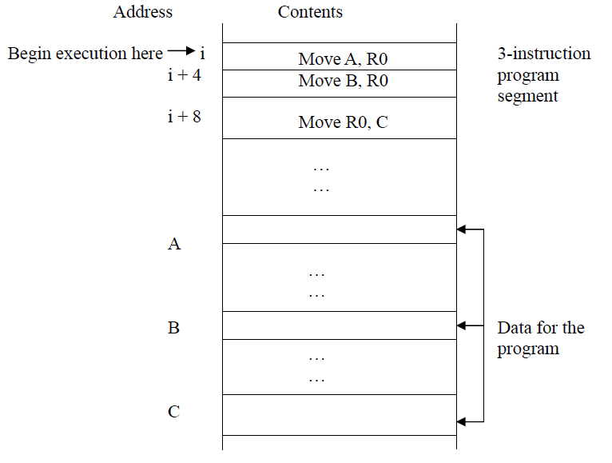

Slide 35
BRANCHING
Branching involves a deviation from the straight line execution.
A branch instruction loads a new value,other than the next sequential address into the PC.
As a result, the processor fetches and executes the instruction at this new address instead of the next instruction in sequence.

Slide 36
A conditional branch instruction causes a branch to happen only if a specific condition is satisfied.
If condition is not satisfied, the PC is incremented in the normal way and the next instruction in sequential order is fetched and executed.

Slide 37
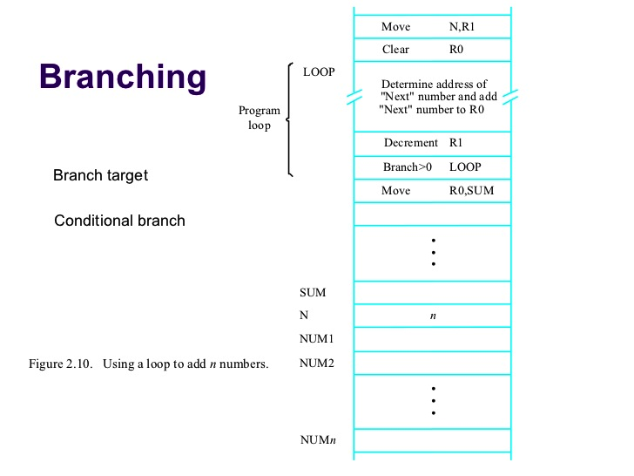

Slide 38
ADDRESSING MODES
The address of an operand can be specified in different ways in an instruction – need not always be given directly.
These different ways in which the address of an operand is specified in an instruction are called addressing modes.
Provides flexible means of accessing operands.

Slide 39
Variables and Constants
Simplest data types.
Two addressing modes are used to access variables:
1) Register Mode
The operand is placed in a processor register.
The name of this register is given in the instruction. Eg: Add R1

Slide 40
2) Absolute Mode
The operand is in a memory location.
The address of this location is given explicitly in the instruction.
Eg: Let LOC represent the memory address 1008, then , Add LOC, adds contents of 1008 to accumulator.

Slide 41
To represent constants another addressing mode is used.
3) Immediate Mode
The operand value is given directly in the instruction. Used only to specify the value of a source operand.
Eg: Move #5,R0, places the value 5 in register R0.
Add #6,R1 adds 6 to contents of R1.

Slide 42
Indirection and Pointers
In this case, the instruction does not give the operand value or its address explicitly.
Instead it provides information, from which the memory address of the operand can be determined.
This calculated address is called the Effective Address (EA) of the operand.

Slide 43
4) Indirect Mode
The effective address of the operand is the content of a register or memory location, whose address is given in the instruction.
This register or memory location that contains the address of operand is called a pointer.

Slide 44
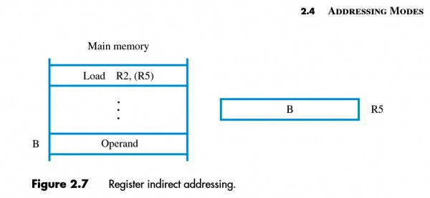

Slide 45
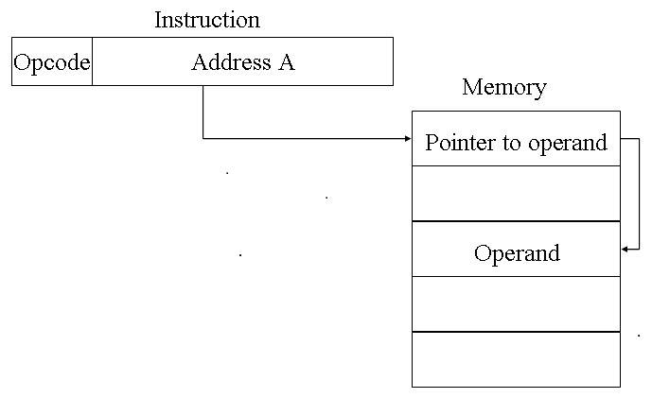

Slide 46
Indirect addressing mode corresponds to high level language statements using pointers.
The C language statement, A=*B, where B is a pointer variable, can be represented as: Move (B), A
The contents of address in B will be moved to A.

Slide 47
Indexing & Arrays
Used to access individual elements from an array.
5) Index Mode
The effective address of the operand is generated by adding a constant value to the contents of a register.
The register used for this purpose is called a index register.

Slide 48
Symbolically represented as X(Ri), where X denotes the constant value and Ri is the index register.
EA = X+[Ri]
The index register can contain either the address of a memory location or an offset value.

Slide 49
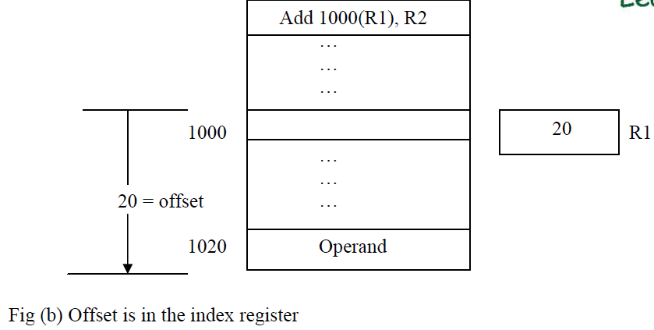

Slide 50
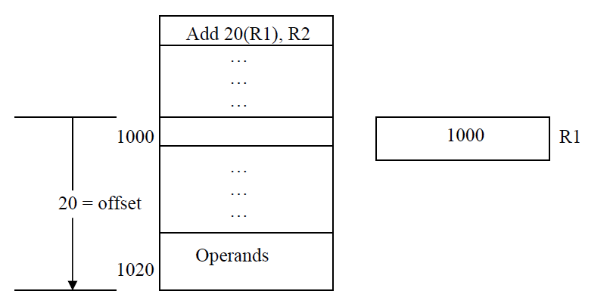

Slide 51
Very often, a chunk of data is stored as a complete block in memory.
For example, it makes sense to store arrays as contiguous blocks in memory.
The array has a 'base address' which is the location of the first element, then an 'index' is used that adds an offset to the base address in order to fetch any other element within the array.

Slide 52
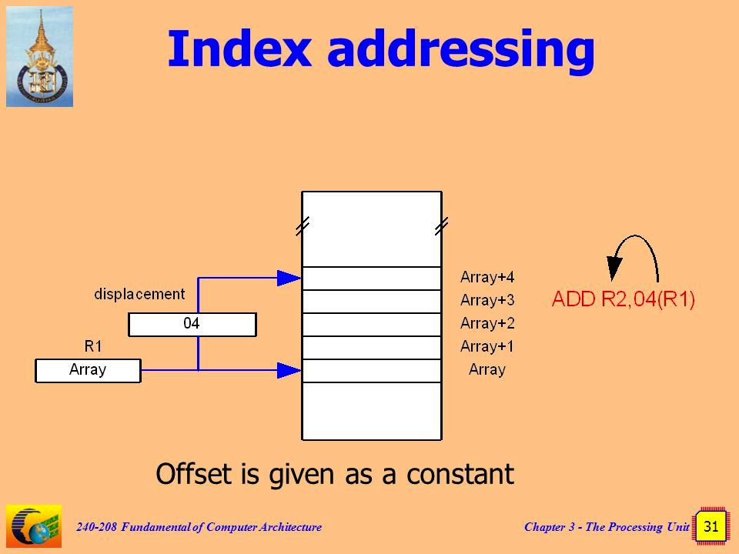

Slide 53
In general, the index mode facilitates access to an operand whose location is defined relative to a reference point within the data structure where the operand appears.
Index mode can also be accomplished using two registers, represented as (Ri,Rj) or using two registers and an offset, X(Ri,Rj)
EA=[Ri]+[Rj] or EA = X+Ri+Rj

Slide 54
RELATIVE ADDRESSING
A version of index mode, where PC is used as the index register.
Represented as X(PC) and it represents a memory location that is X bytes away from the location pointed to by PC.
EA = X+[PC]
Most common use is to specify target address in branch instructions.

Slide 55
During the fetching and execution of an instruction, the content of PC is updated.
This updated value will be used for calculating the effective address.
In case of relative addressing, X is often called the displacement.

Slide 56
AUTOINCREMENT MODE
The EA of the operand is the content of a register specified in the instruction.
After accessing the operand, the contents of this register are automatically incremented to point to next item in a list.
The increment value corresponds to size of accessed operand. (1 for byte operands, 4 for word operands in case of 32 bit address)
Represented as (Ri)+

Slide 57
Let register R2 contain the address 1004 which holds a 1 word data.
The instruction Add (R2)+,R0 adds the contents of 1004 to the contents of register R0 and increments the contents of R2 by 4.
New content of R2 after the operation is 1008.

Slide 58
Example program using auto increment mode – to find sum of N numbers, which are stored in continuous memory locations.
N is placed in register R1
R2 contains NUM, which is the starting address of numbers in memory.

Slide 59
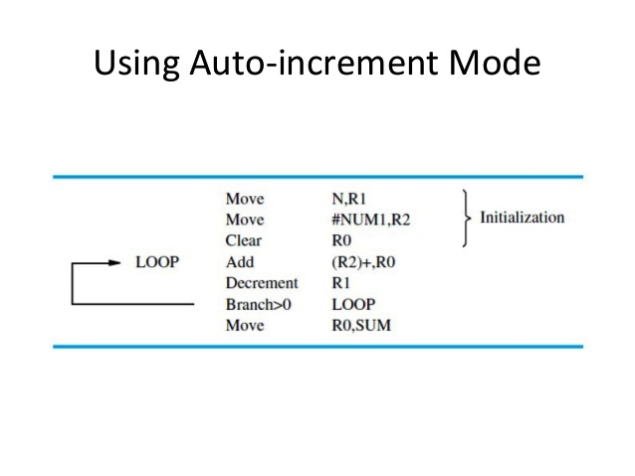

Slide 60
AUTODECREMENT MODE
The contents of register specified in the instruction are first automatically decremented and then used as the effective address of operand.
Denoted by -(Ri)
The operands are accessed in decreasing address order.

Slide 61
Let register R2 contain the address 1008 which holds a 1 word data.
The instruction Add -(R2),R0 decrements the contents of R2 to 1004 and adds the data at this location to content of register R0.
New content of R2 after the operation is 1004.

Slide 62
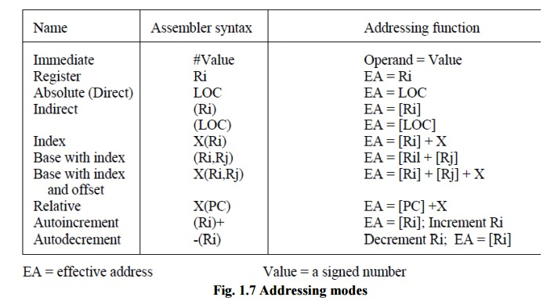

Slide 63
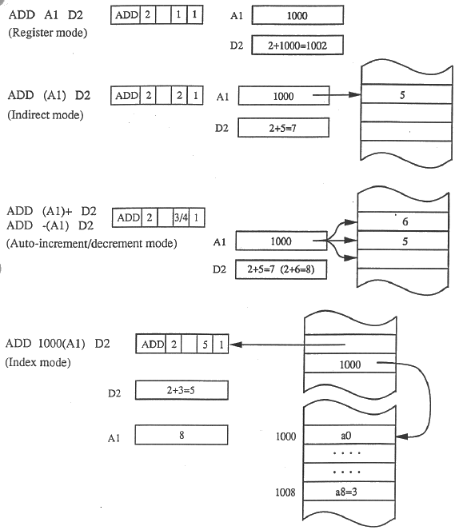

Slide 64
STACKS
A stack is a list of data elements with the restriction that elements can be added or removed only at one end – called top of stack.
LIFO data structure
Adding an item – push operation
Deleting an item – pop operation

Slide 65
Data stored in computer memory is sometimes organised as a stack, with successive elements occupying successive memory locations.
First element is placed at the location BOTTOM and when new elements are pushed to stack they are placed in successive lower address locations.

Slide 66
A stack grows in the decreasing direction of memory addresses.
A processor register is used to keep track of the address of the element that is at the top of stack at any given time.
This register is called stack pointer (SP).

Slide 67
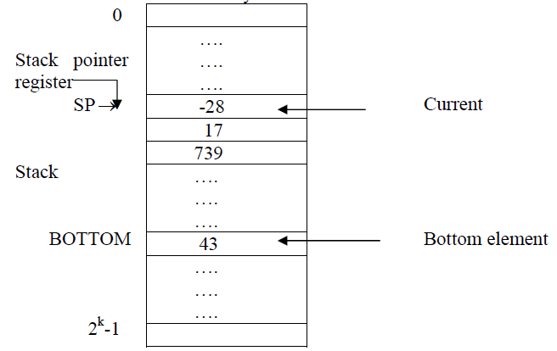

Slide 68
If we assume a 32 bit word length, the push operation can be implemented as,
Subtract #4,SP
Move NEW_ITEM,(SP)
Pop operation can be implemented as,
Move (SP),ITEM
Add #4, SP

Slide 69
If the processor has auto increment and auto decrement addressing modes, then the push and pop operation can be performed by single operations:
Push - Move NEW_ITEM,-(SP)
Pop - Move (SP)+,ITEM

Slide 70
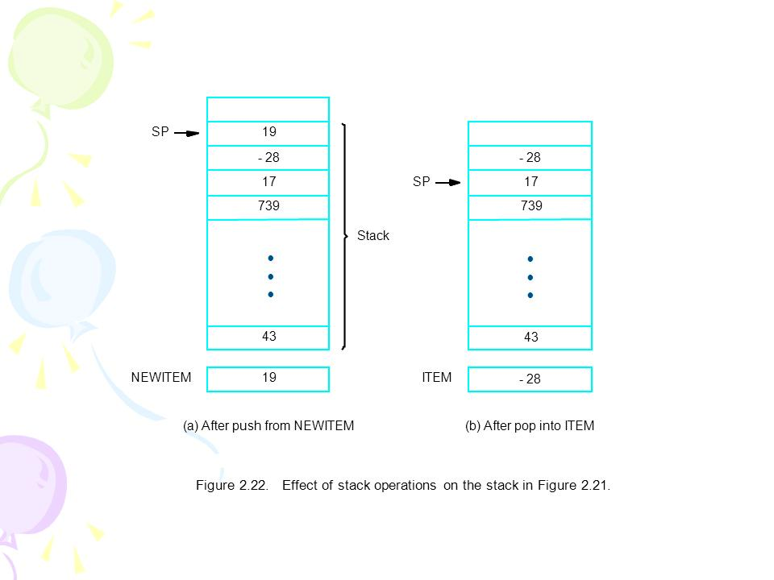

Slide 71
We must avoid pushing into a full stack or popping from an empty stack.
During POP operation if SP contains a value greater than the starting address (BOTTOM) of stack, it indicates an underflow.
During PUSH, if SP contains a value less than the last address allotted for stack, it signals an overflow.

Slide 72
SUBROUTINES
In a program, it is often necessary to perform a subtask many times on different data values.
Such a subtask is usually implemented as a subroutine.
Only one copy of the instructions that constitute a subroutine is placed in memory.

Slide 73
The program contains references to the subroutine.
During the execution of these subroutine calls, a branching occurs to the starting location of the subroutine.
After the subroutine has finished execution, the calling program must resume execution.

Slide 74
The execution resumes from the instruction immediately after the one that called the subroutine.
This is called return from subroutine and is accomplished by a Return instruction at the end of the subroutine.
The address of the resuming instruction should be available for the return to happen.

Slide 75
When a subroutine call instruction is being processed, the PC normally would have been updated to the address of next instruction in sequence.
The execution of call instruction replaces this address in PC and loads the address of first instruction of the subroutine.
The contents of PC must be saved so that it can be used for return from subroutine.

Slide 76
The way in which a computer makes it possible to call and return from subroutines is called subroutine linkage.
The simplest method for subroutine linkage is to use a special register to store the return address.
Such a register is called the link register.

Slide 77
Call instruction
  Store contents of PC in link register.
  Branch to target address specified by the call instruction.
Return instruction
  Load PC with address contained in link register and branch back to main program.

Slide 78
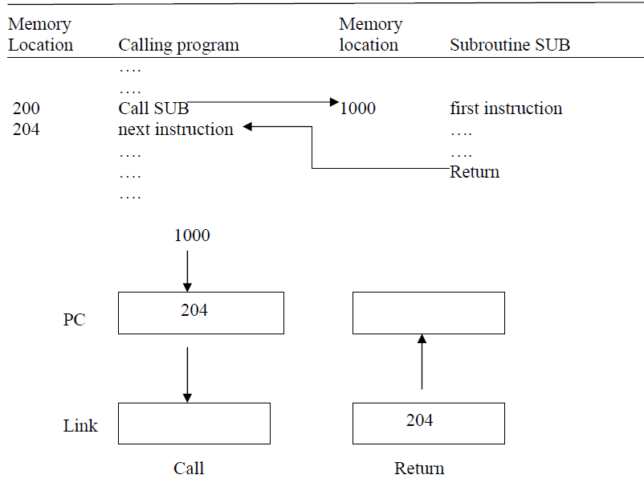

Slide 79
SUBROUTINE NESTING
Subroutine nesting means one subroutine calling another subroutine.
In this case the return address of the second call is also stored in the link register, thereby destroying the original return address.
Hence it is essential to have a mechanism to store all return addresses, since nesting can be done to any depth.

Slide 80
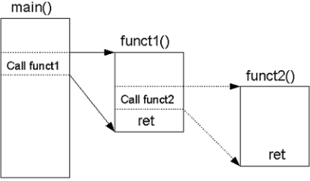

Slide 81
In a nested subroutine, the last subroutine called, completes its execution and returns to the subroutine that called it.
The return address needed for this first return is the last one generated in the nested call sequence.
So, the return addresses are generated and used in a LIFO order.

Slide 82
This LIFO structure makes it possible to use stacks for storing the subroutine return addresses.
Such a stack is called the processor stack.
The call instruction pushes contents of PC into the processor stack and loads subroutine address to PC.
Return instruction pops the return address from stack to PC.

Slide 83
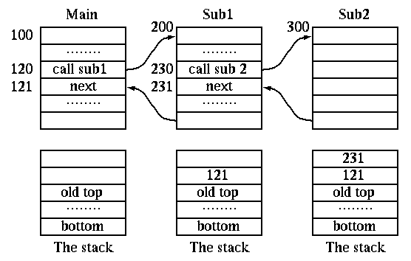

Slide 84
PARAMETER PASSING
During a subroutine call, the program must provide the parameters to be used in the subroutine.
Later the subroutine returns the results .
This exchange of information is called parameter passing.

Slide 85
Parameter passing can be done in different ways.
One way is to place the parameters in memory locations or registers from where they can be accessed by the subroutine.
Alternatively, the parameters may also be placed into the processor stack.

Slide 86
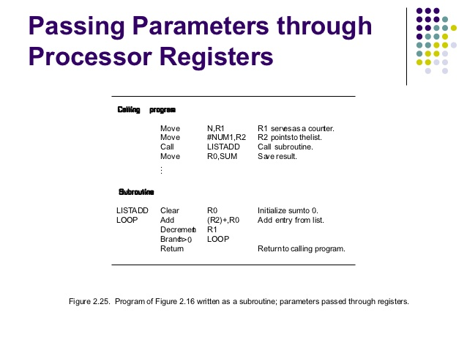

Slide 87
If many parameters are involved, there may not be enough general purpose registers available for passing them to the subroutine.
Using a stack is highly flexible, as it can handle a large number of values.

Slide 88
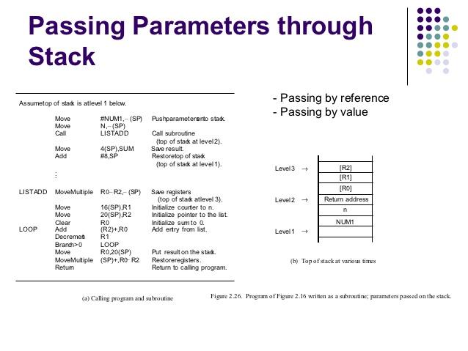

Slide 89
During the execution of the subroutine, some locations in the stack are allotted as the private workspace for it.
These locations are used when the subroutine is entered and freed when it is exited.
Such a space is called a stack frame.
Each subroutine has its own stack frame.

Slide 90
Within a stack frame, one more pointer is used in addition to the stack pointer (SP).
This is called Frame Pointer (FP) and provides convenient access to the parameters and local variables inside the stack frame.
The frame pointer always points to the beginning of stack frame, unlike SP which must change as new elements are added.

Slide 91
Consider a program which calls one subroutine, passes 4 parameters and uses 3 local variables..
The 4 parameters are first pushed to the stack by the calling program and then the subroutine is called.
The return address is then pushed to stack and SP points to this location.
.

Slide 92
Now the FP is initialized
FP itself is a processor register and may contain relevant information, so the old contents of FP register are also pushed to stack.
Now SP points to this location.

Slide 93
The current address of SP is copied to FP.
Thus, the first two instructions executed in the subroutine are
Move FP, -(SP)
Move SP, FP
After these instructions are executed, both SP and FP point to the saved FP contents and this is the beginning of current stack frame.

Slide 94
Now the space for the 3 local variables are allotted in stack by performing
Subtract #12, SP
The subroutine uses 2 processor registers R0 and R1,hence their old contents are also pushed into the stack.

Slide 95
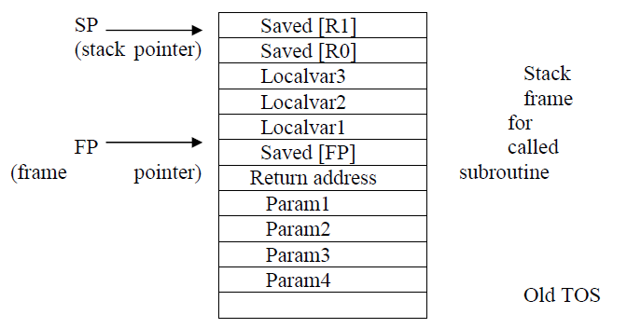

Slide 96
The parameters can be accessed with reference to FP, like 8(FP),12(FP)…
Local variables can be accessed using -4(FP),-8(FP)….
The contents of FP remains fixed throughout the execution of the subroutine.

Slide 97
Once the subroutine finishes execution, the saved values of R1 and R0 are popped back in to the registers.
The local variables are removed from stack by performing Add #12,SP.
The old value of FP is popped back to the register.
Now SP points to the return address, so the Return instruction is executed.

Slide 98
Stack Frames For nested Subroutines
Complete stack frames are built for each of the nested subroutines.
Here the old contents of FP saved in current stack frame are the FP contents for the previous stack frame.
Consider an example program with two subroutines.

Slide 99
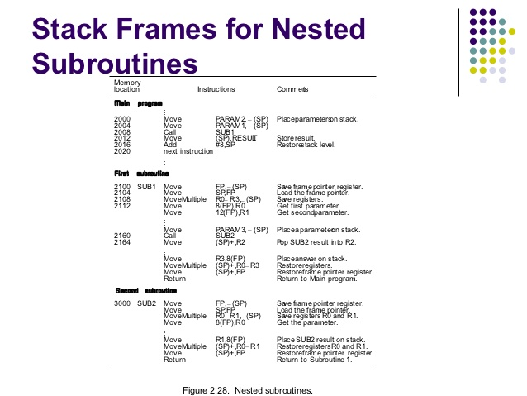

Slide 100
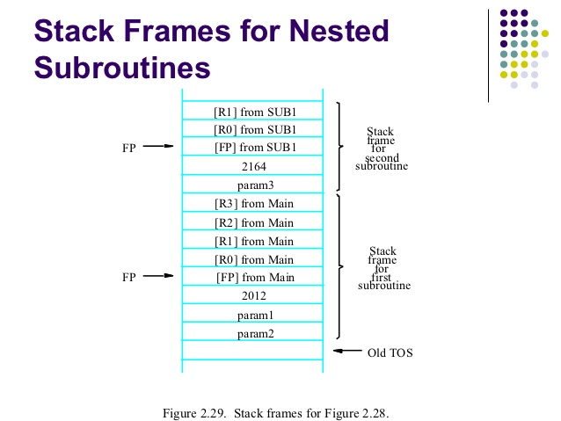

Slide 101
The main program pushes two parameters into the stack and calls SUB1.
During its execution SUB1 calls SUB2 after pushing a single parameter to the stack.
The current content of FP is pushed to stack and the stack frame for SUB2 is built.

